Slide 1

Student Database Management System

Slide 2
TEAM MEMBERS
Anuragavi CS
Charulatha C
Devadharshini KS
Dharani V
Divya T

Slide 3
MODULES
Insert Student
Login
Update Student Details
Delete Student Details
Search Student by Name
Display All Students
Calculate Average GPA
Display Subject Marks

Slide 4
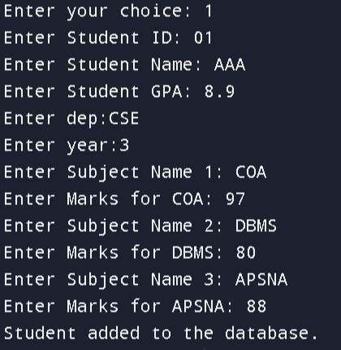
Insertion Module :
This insertion function typically refers to the process of adding
new student information system.
This function is crucial for keeping the database up-to-date
with latest data of students.
Output looks like this:

Slide 5
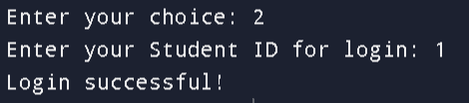
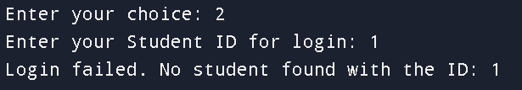
Login Module :
In this function ,the user gets the student id.If the student id
already exists in the database,then login will be successful.
Output looks like this:
If the login id does not exist,then login will be failed.
Output looks like this:

Slide 6
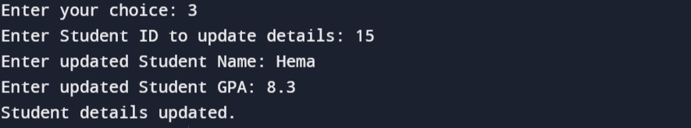
Update Details module :
The update module is used to alter or update the already entered .

Slide 7
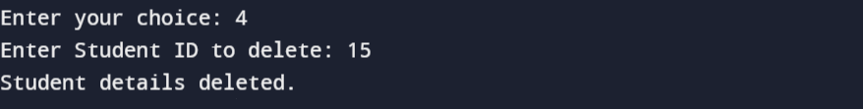
Delete Details Module :
The delete module can delete the already saved student details in the database.

Slide 8
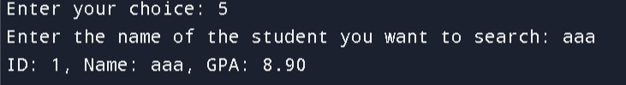
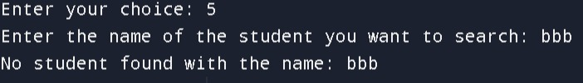
SEARCH :
Search module typically involves traversing the data
to find a specific element .
The output is as follows if the data is found:
If the data is not found and the output is as follows:

Slide 9
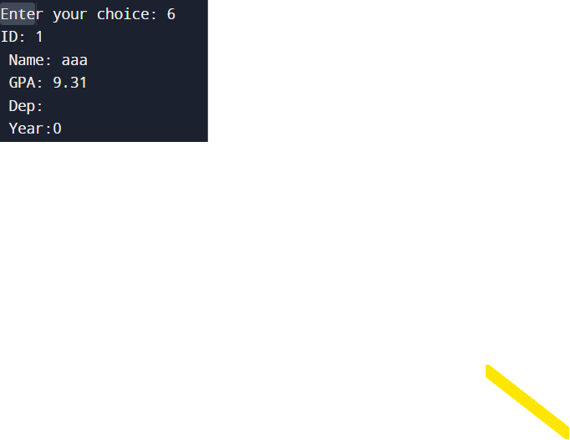
DISPLAY STUDENT :
Display typically used to find a stored, generated and transmitted data In the data structure.
The output is as follows:

Slide 10

CALCULATE AVERAGE GPA:
To calculate your GPA, divide the total number of grade points earned by the total number of letter graded units undertaken.

Slide 11
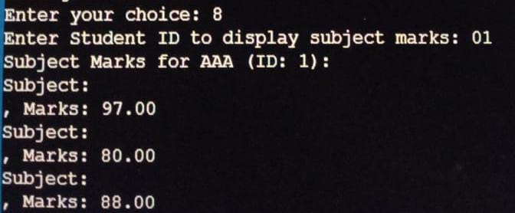
DISPLAY SUBJECT MARKS:
Displaying all the subject marks from the given student ID.

Slide 12
THANK YOU!

